Slide 1
X Education - Lead Scoring Case Study
Identification of Hot Leads to focus more on them and thus enhancing the conversion ratio for X Education
Group Members:
Sachin Sonavane
Shubham Satbhai
V Sarat suhas

Slide 2
Background
X Education Company
An education company named X Education sells online courses to industry professionals. On any given day, many professionals who are interested in the courses land on their website and browse for courses.
The company markets its courses on several websites and search engines like Google. Once these people land on the website, they might browse the courses or fill up a form for the course or watch some videos. When these people fill up a form providing their email address or phone number, they are classified to be a lead. Moreover, the company also gets leads through past referrals. Once these leads are acquired, employees from the sales team start making calls, writing emails, etc. Through this process, some of the leads get converted while most do not. The typical lead conversion rate at X education is around 30%.
Now, although X Education gets a lot of leads, its lead conversion rate is very poor. For example, if, say, they acquire 100 leads in a day, only about 30 of them are converted. To make this process more efficient, the company wishes to identify the most potential leads, also known as ‘Hot Leads’. If they successfully identify this set of leads, the lead conversion rate should go up as the sales team will now be focusing more on communicating with the potential leads rather than making calls to everyone. A typical lead conversion process can be represented using the following funnel:

Slide 3
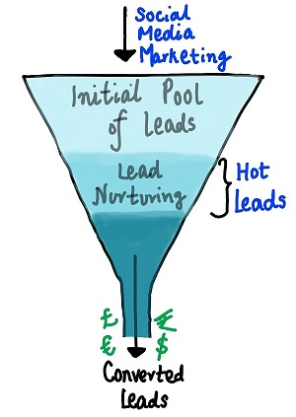
Problem Statement
As you can see, there are a lot of leads generated in the initial stage (top) but only a few of them come out as paying customers from the bottom. In the middle stage, you need to nurture the potential leads well (i.e. educating the leads about the product, constantly communicating etc. ) in order to get a higher lead conversion.
X Education has appointed you to help them select the most promising leads, i.e. the leads that are most likely to convert into paying customers. The company requires you to build a model wherein you need to assign a lead score to each of the leads such that the customers with a higher lead score have a higher conversion chance and the customers with a lower lead score have a lower conversion chance. The CEO, in particular, has given a ballpark of the target lead conversion rate to be around 80%.

Slide 4
Lead – Conversion Process
Lead Generation:
1. Ads on websites like Google
2. Referrals
Visit to X Education website by these potential customers (professionals)
Visitors either provide Email id & Contact Details
Or
View videos etc
Tele calling and Emailing activity to all the leads
~30% leads get converted
Lead to Conversion process
Proposed Solution:
A model to filter leads so that leads to conversion ratio is 80%+

Slide 5
Proposed Solution
Selection of Hot Leads
Communicating with Hot Leads
Conversion of Hot Leads
Leads Clustering
We categorize leads based on their likelihood or probability to convert, enabling us to focus on a smaller section of hot leads
Focus Communication
Having a smaller set of leads to communicate with allows us to make a greater impact with effective communication
Increase conversion
By focusing on hot leads that are more likely to convert, we can achieve a better conversion rate, allowing us to reach our 80% target.

Slide 6
Solution
Selection of Hot Leads The key to our problem solution is accurately identifying hot leads. The more accurately we identify hot leads, the higher our chances of achieving a better conversion ratio. Since our goal is an 80% conversion rate, it's essential to obtain a high level of accuracy in identifying hot leads.

Slide 7
Implementation

Slide 8
Loading & Observing the past data provided by the Company
Univariate, Bivariate, and Heatmap for numerical and categorical columns
Performing pre-requisites for RFE and Logistic Regression
Data Gathering
Data Cleaning
Performing EDA
Data Preparation
Model Building
Duplicate removal, null value treatment, unnecessary column elimination, etc.
Outlier Treatment, Feature-Standardization

Slide 9
Selection of top 25 features using RFE
Reduction of columns and Model re-building
Verifying our Final Model Accuracy etc. with model built with PCA
Feature Selection
Model Building
Model Improvement
Final Model
Verifying with PCA
Model building using RFE for selected columns
Final Model Analysis and performance on Test Data

Slide 10
Plots (Visualization)

Slide 11
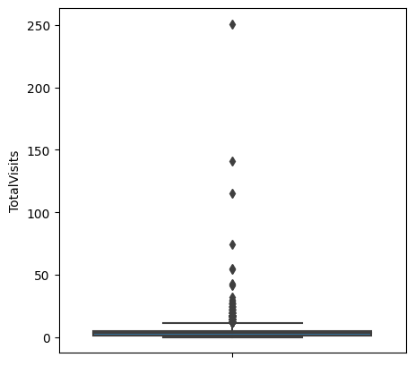
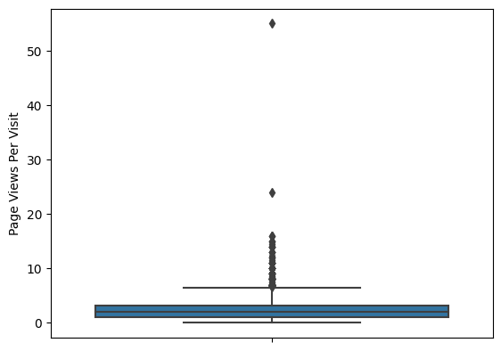
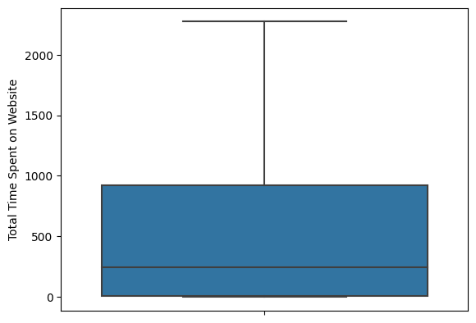
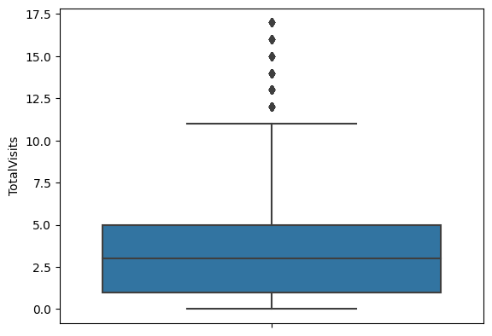
EDA plots depicting variation in numerical columns for those who Converted and those who didn't.

Slide 12
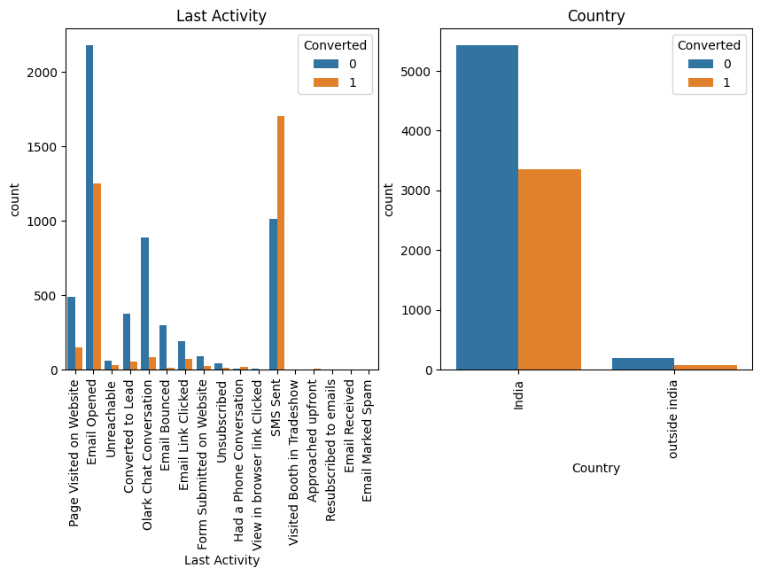
EDA plots depicting variation in categorical column (Last Activity) for those who Converted and those who didn't.

Slide 13
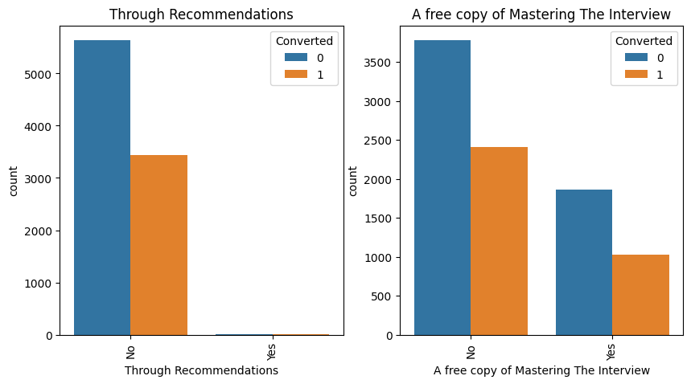
EDA plots depicting variation in categorical column (A free copy of Mastering The Interview) for those who Converted and those who didn't.

Slide 14
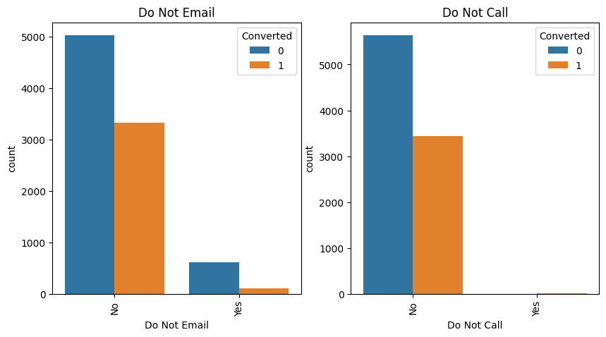
EDA plots depicting variation in categorical column (Do Not Email) for those who Converted and those who didn't.

Slide 15
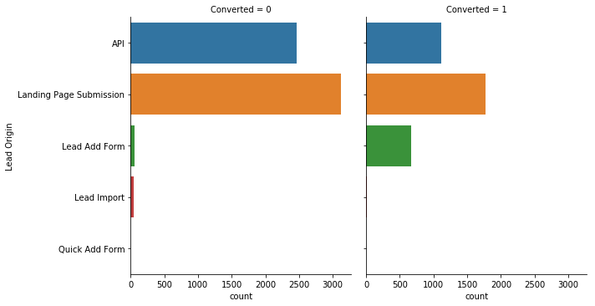
EDA plots depicting variation in categorical column (Lead Origin) for those who Converted and those who didn't.

Slide 16
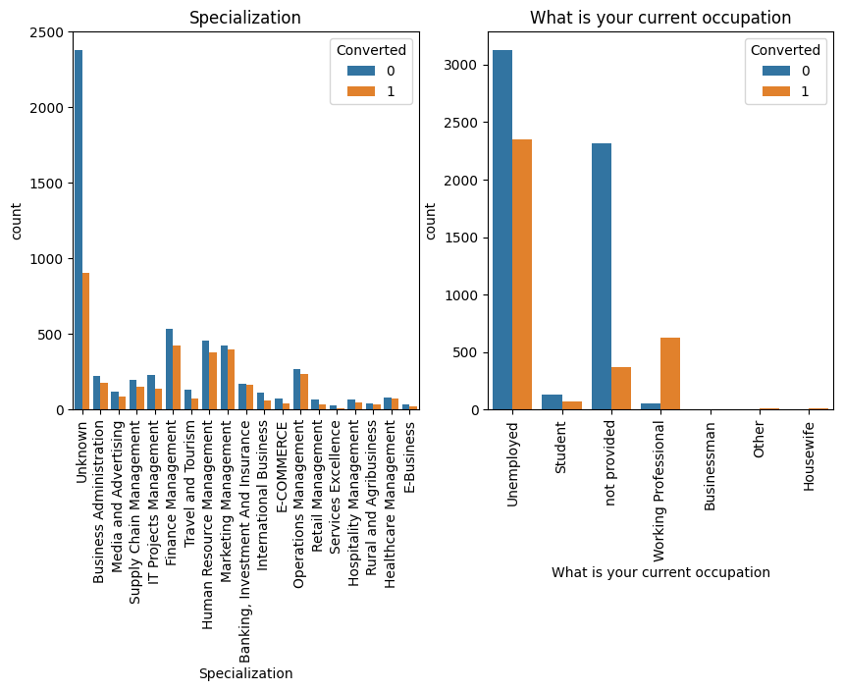
EDA plots depicting variation in categorical column (Specialization & current occupation) for those who Converted and those who didn't.

Slide 17
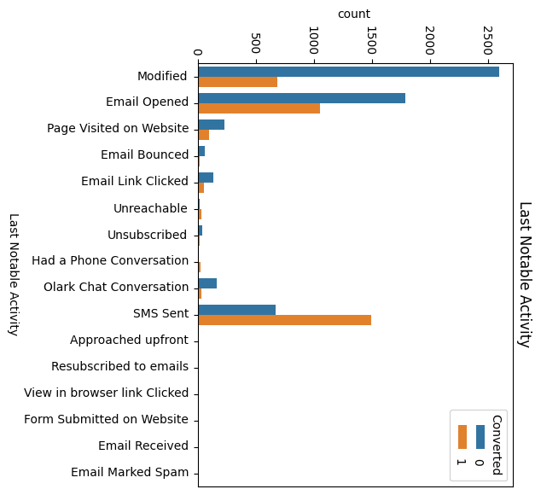
EDA plots depicting variation in categorical column (Last Notable Activity) for those who Converted and those who didn't.

Slide 18
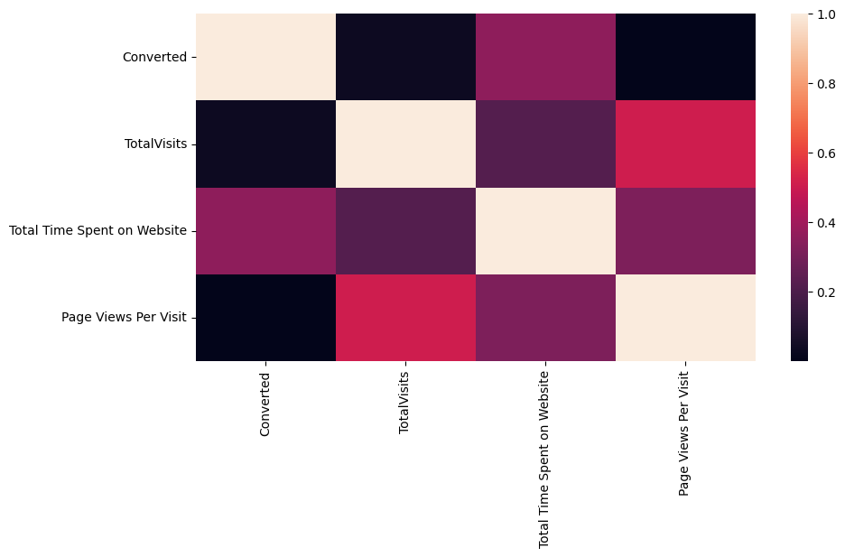
EDA plots depicting correlation (Heat Map) of all selected numerical columns.

Slide 19
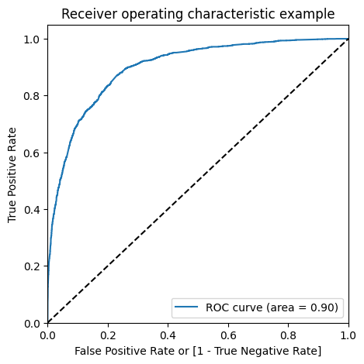
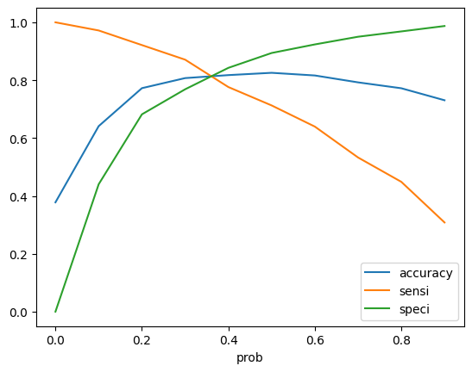
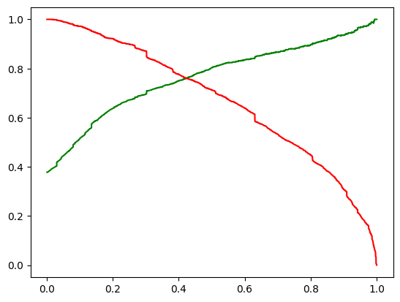
Linear Regression Final Model Parameters
Area under ROC = 0.90
Intermediate cut-off = 0.35
Final cut-off = 0.42

Slide 20
Inference / Conclusion

Slide 21
Model Analysis
Check the overall accuracy
With the current cut off as 0.41 we have Precision around 75% , Recall around 75% and accuracy 81%.
The Model seems to predict the Conversion Rate very well and we should be able to give the CEO confidence in making good calls based on this model
Optimise Cut off (ROC Curve)
With the current cut off as 0.35 we have accuracy, sensitivity and specificity of around 81% Prediction on Test set
With the current cut off as 0.35 we have accuracy, sensitivity of around 82% and specificity of around 80%
Precision-Recall
With the current cut off as 0.35 we have Precision around 80% and Recall around 71%
Precision and recall tradeoff
With the current cut off as 0.44 we have Precision around 75% and Recall around 76.3% and accuracy 82 %.

Slide 22
Inferences from Model
Top 3 variables in model, that contribute towards lead conversion are:
Total Time Spent on Website
Last Notable Activity_SMS Sent
TotalVisits
Business Insights Derived from our Model

Slide 23
Inferences from Model
Top 3 variables in my model, that should be focused are:
Last Activity_SMS Sent (positively impacting)
Last Activity_Olark Chat Conversation (negatively impacting)
Lead Source_Olark Chat (negatively impacting)
Business Insights Derived from our Model

Slide 24
Conclusion
To improve the overall conversion rate, X Education Company needs to focus on the following key aspects:
Increasing user engagement on their website, as this leads to higher conversions.
Sending more SMS notifications, which has been shown to increase conversion rates.
Increasing total website visits through advertising and other means, as this is also linked to higher conversions.
Improving the Olark Chat service, as it is currently negatively impacting the conversion rate

